Slide 1

Course Overview

Slide 2
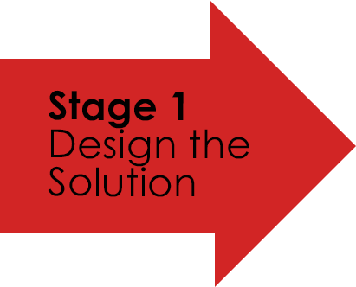

Designing for User Experience

Slide 3
Design Thinking
Design thinking is a creative-problem solving approach designers use to create new values that are different and create positive impact.

Slide 4
Human Centred Design
“User-centered design means understanding what your users need, how they think, and how they behave – and incorporating that understanding into every aspect of your process."
Jesse James Garrett — User Experience Designer

Slide 5
Design Thinking
Design thinking is created because big/tech and corporations often ‘lack the ability to be creative and in extreme cases, aren’t able to create new products and services’ that meet unmet needs of their customers.

Slide 6
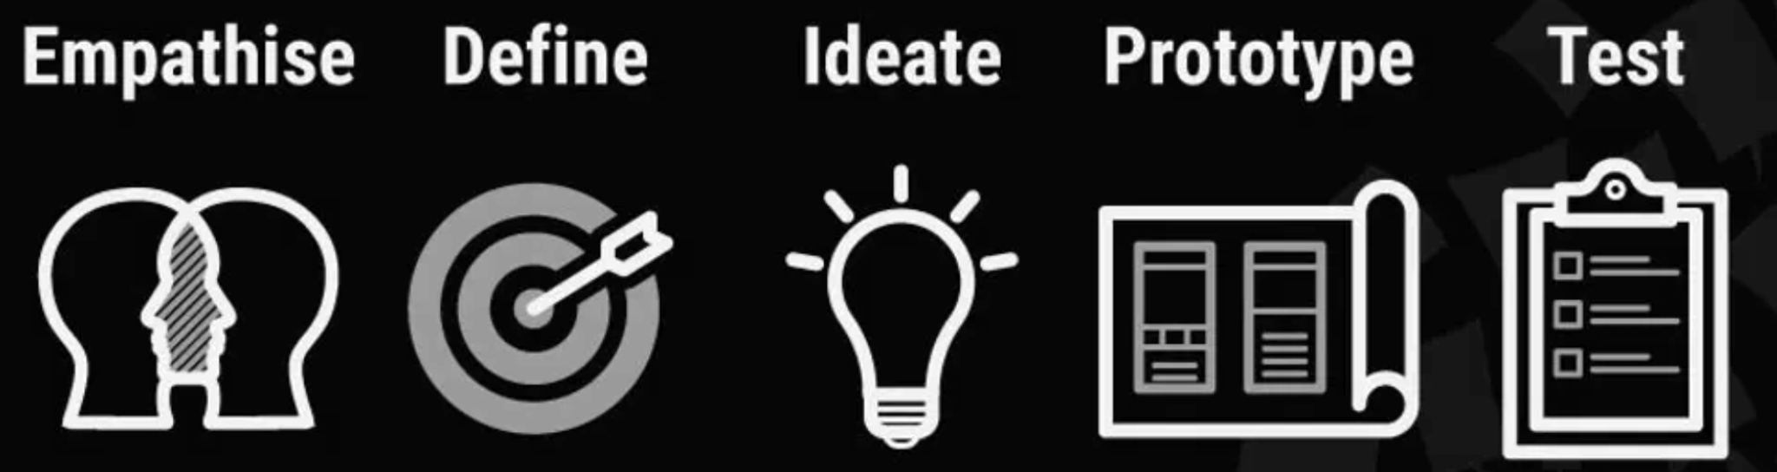
Design Thinking
Empathise Define Ideate Prototype Test
– with your users
– your users’ needs, their problem, and your insights
– by challenging assumptions and creating ideas for innovative solutions
To start creating solutions
- solutions

Slide 7
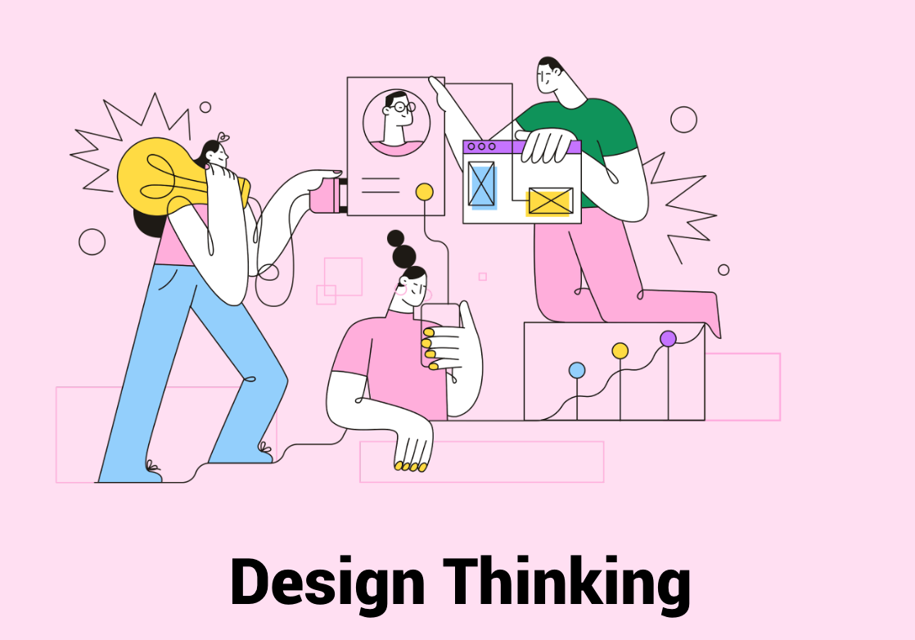
DEEP DIVE

Slide 8
What is UX?
User experience (UX) design is the process design teams use to create products that provide meaningful and relevant experiences to users.
This involves the design of the entire process of acquiring and integrating the product, including aspects of branding, design, usability and function.

Slide 9
Designing for User Experience
What’s special about Design Thinking is that designers’ work processes can help us systematically extract, teach, learn and apply human-centered techniques to solve problems in a creative and innovative way – in our designs, in our businesses, in our countries, in our lives.
Design Thinking is an iterative process in which we seek to understand the user, challenge assumptions, and redefine problems in an attempt to identify alternative strategies and solutions that might not be instantly apparent with our initial level of understanding.
It is most useful when you want to tackle problems that are ill-defined or unknown - and we will use it throughout this subject.

Slide 10
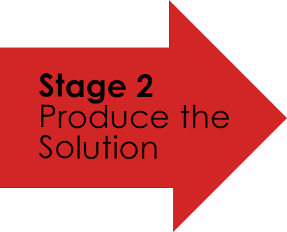

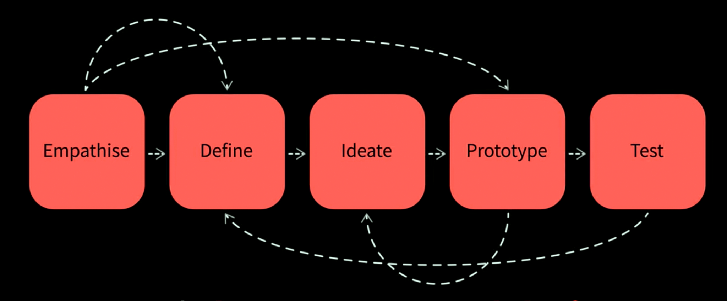

Slide 11
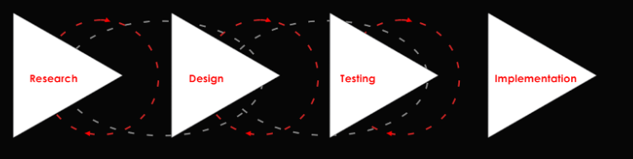
Design Thinking and User Experience Design
UX design stems from Design Thinking theory and is simplified for the purposes of commercial design needs.

Slide 12

User Experience Design
The term was first coined in 1993 by the cognitive psychologist and designer Don Norman when he worked at Apple Computer — but the UX field is older than the term.

Slide 13
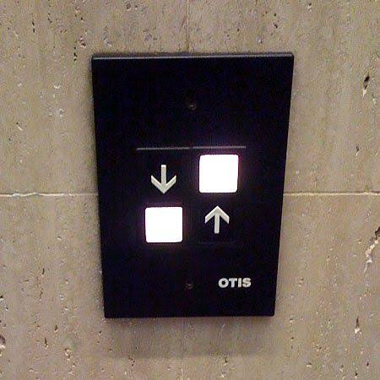
What is UX?
Poor UX examples: https://careerfoundry.com/en/blog/ux-design/10-classic-ux-design-fails/

Slide 14

The UX Process Explained

Slide 15
What is UI Design?
User interface (UI) design is the process of making interfaces in software or computerized devices with a focus on looks or style.
Designers aim to create designs users will find easy to use and pleasurable.
UI design typically refers to graphical user interfaces but also includes others, such as voice-controlled ones.

Slide 16
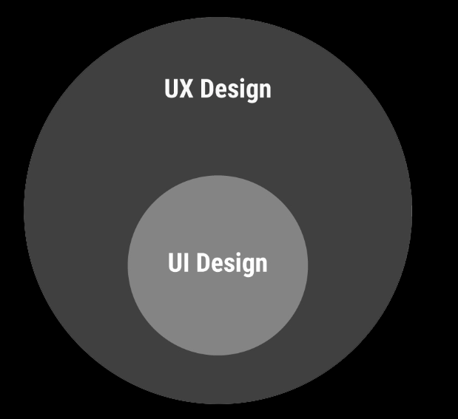
Often confused with UX design, UI design is more concerned with the surface and overall feel of a design, whereas the latter covers the entire spectrum of the user experience.
One analogy is to picture UX design as a vehicle with UI design as the driving console. In GUIs, you should create pleasing aesthetics and animations that convey your organization’s values and maximize usability.

Slide 17
Basic Principles of User Interface Design (Video)
https://www.interaction-design.org/literature/topics/ui-design

Slide 18
UI Test - Fun
https://cantunsee.space/

Slide 19
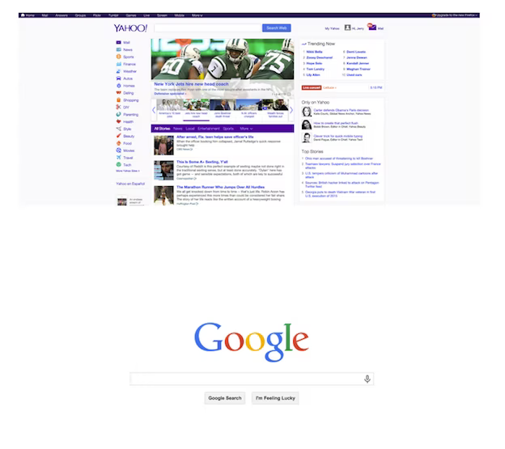
Embracing Space in Interaction Design
https://99designs.com.au/blog/tips/embracing-space-interaction-design/
Google understands that users want to find things - so the design objective is easy - make it stand out

Slide 20
Basic Principles of User Interface Design
Ask - What is the user doing?
Think - What information, comparisons, order
Design - Form follows function

Slide 21
Basic Principles of User Interface Design
Grouping of items
Order of items
Decoration - fonts, boxes, bevels etc
Alignment of items
White space between items

Slide 22
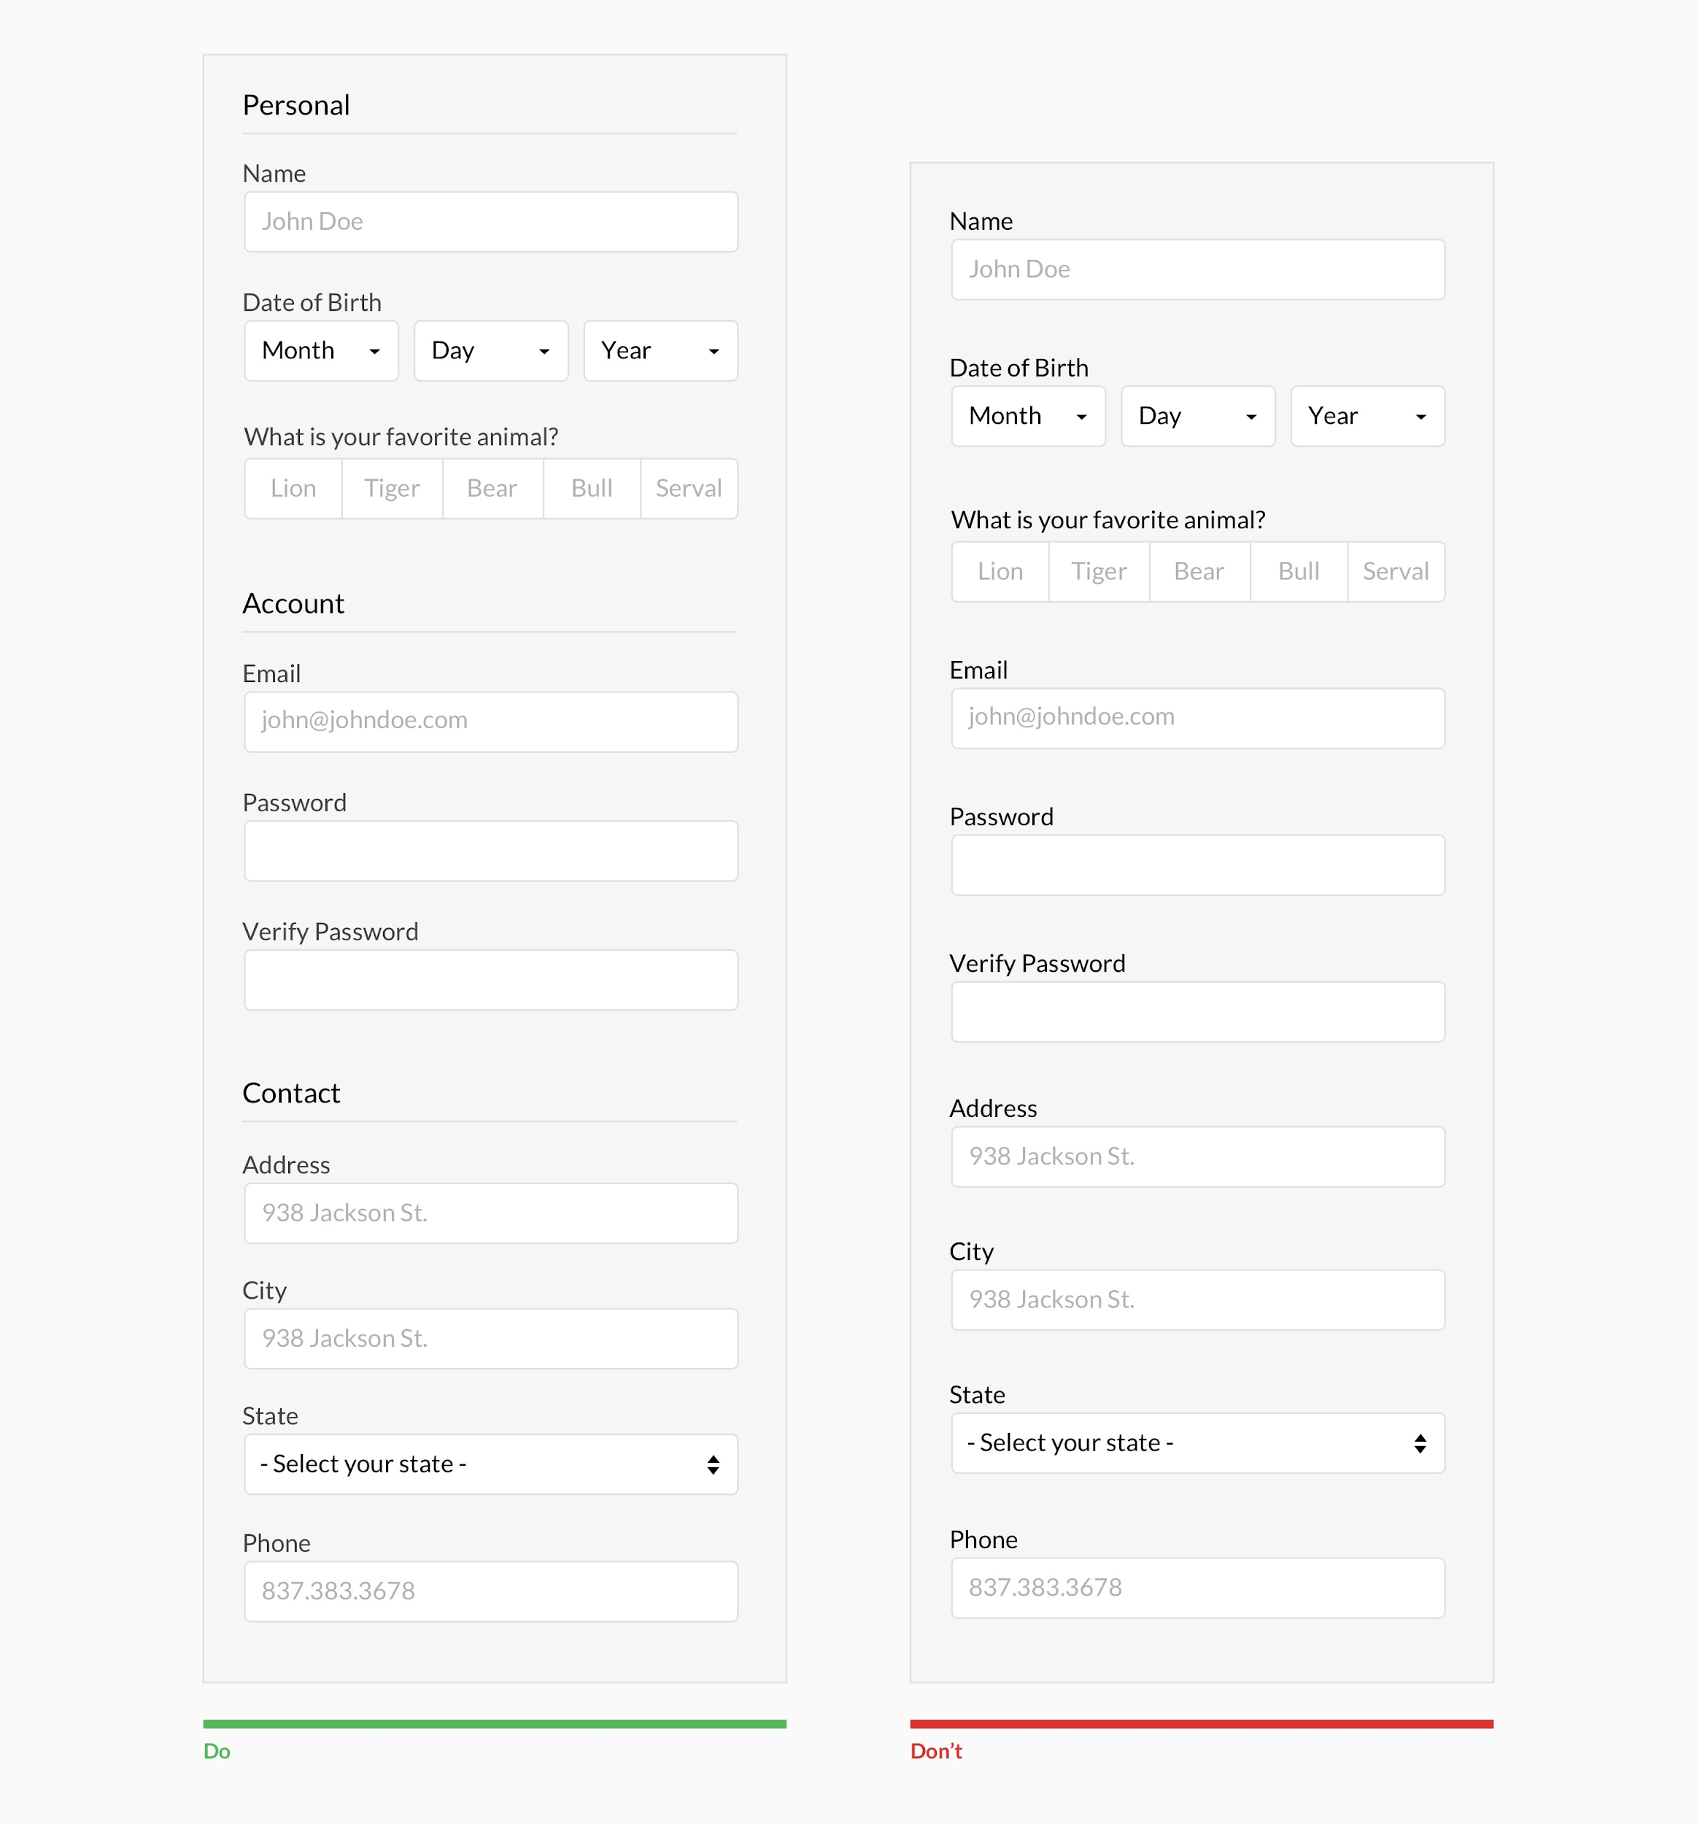
Grouping of relevant content

Slide 23
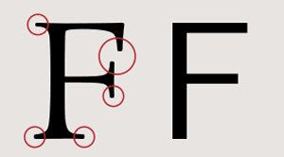
Serif vs Sans Serif
To break it down very simply, Serif fonts are easily readable at small body copy sizes, and Sans Serif fonts really stand out in large titles. There are many exceptions to this, but that is the most common usage. One major exception is on screen.

Slide 24
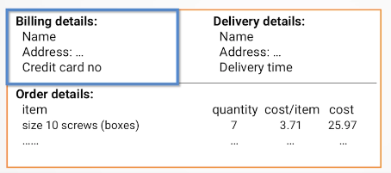
Basic Principles of User Interface Design
Grouping & Structure
If they belong together logically - physically group them

Slide 25
Basic Principles of User Interface Design
Order of Groups and Items
Think - what is the natural order, what sequentially makes sense.
Should match the screen order - use boxes, space etc.
Set up tabbing to visually group relevant items
Do not give an instruction if a later instruction conflicts with it or would have been beneficial earlier
Eg: (mix flour and milk, add the fruit after beating them)

Slide 26
Basic Principles of User Interface Design
Use boxes (or tints) to group logical items
Use fonts for emphasis, headings - limit these
Align text for optimal reading or effect
Consider the ability to read across gaps (forms, tabbed areas)
Use leaders or alternating coloured rows

Slide 27
User Research
User research is the systematic study of the goals, needs, and capabilities of users so as to specify the design, construction, or improvement of tools to benefit how users work and live.

